Slide 1
Language Barriers in Healthcare
Saadiq Moolla
December 2017

Slide 2
The RSA and WC Context
11 Official Languages
English, Afrikaans & Xhosa predominate in WC
Immigrants

Slide 3
Healthcare Context
Numerous Barriers to Healthcare
  Cost
  Transport
  Waiting times
  Supplies
  Other responsibilities
  Education
  Language

Slide 4
Healthcare Context
Doctors
  Predominantly speak English and Afrikaans
  From other parts of the country
  From other countries/continents
Time constraints
  Typical clinic doctor expected to see +/- 40 patients in a day
Few consultations in home language
  6% in one study¹
Levin ME. Language as a barrier to care for Xhosa-speaking patients at a South African paediatric teaching hospital. S Afr Med J. 2006 Oct; 96 (10): 1076-9.

Slide 5
Effects of the Language Barrier
Patients
  Have difficulty making themselves understood
  Have difficult understanding the doctor
  Have difficulty asking questions
  Reduced ability to participate in decision-making
    Implications for informed consent
  Are dissatisfied with the communication
  Are concerned about the negative effects
  Fear
  Frustration

Slide 6
Effects of the Language Barrier
Doctor
  Difficulty establishing rapport, being kind empathic or approachable
  Wrong history
  Unable to give adequate health education
  Time
  Frustration
Systemic
  Increased cost of investigation

Slide 7
Effects of the Language Barrier
Delayed or incorrect diagnosis
Reduction in patient understanding of
  Diagnosis
  Management/Treatment
    Following health education/promotion
    Using treatment incorrectly
    Defaulting
  Follow up
    Patients lost to the system
Non-adherence to medical advice

Slide 8
Effects of the Language Barrier
Language-intensive problems
  Psychosocial problems
  Mental Health

Slide 9
Current Solutions
Interpreters
  May be
    Ad hoc
    Nurses
    Telephonic
    Professional
  Problems
    Broken telephone
    Time-consuming
    Subverts doctor-patient relationship
    Confidentiality, sensitivity and agendas

Slide 10
Current Solutions
Codeswitching
Language education in the medical curriculum
There remains a lack of research and policy attention to the issue!

Slide 11
Cultural competence
Direct language translation is not enough
Words and ideas may not translate directly
Patients have different understandings of disease to doctors
Explanations need to be at the appropriate level for the patient to understand

Slide 12
Mobile Translate MD
Saadiq Moolla
December 2017

Slide 13
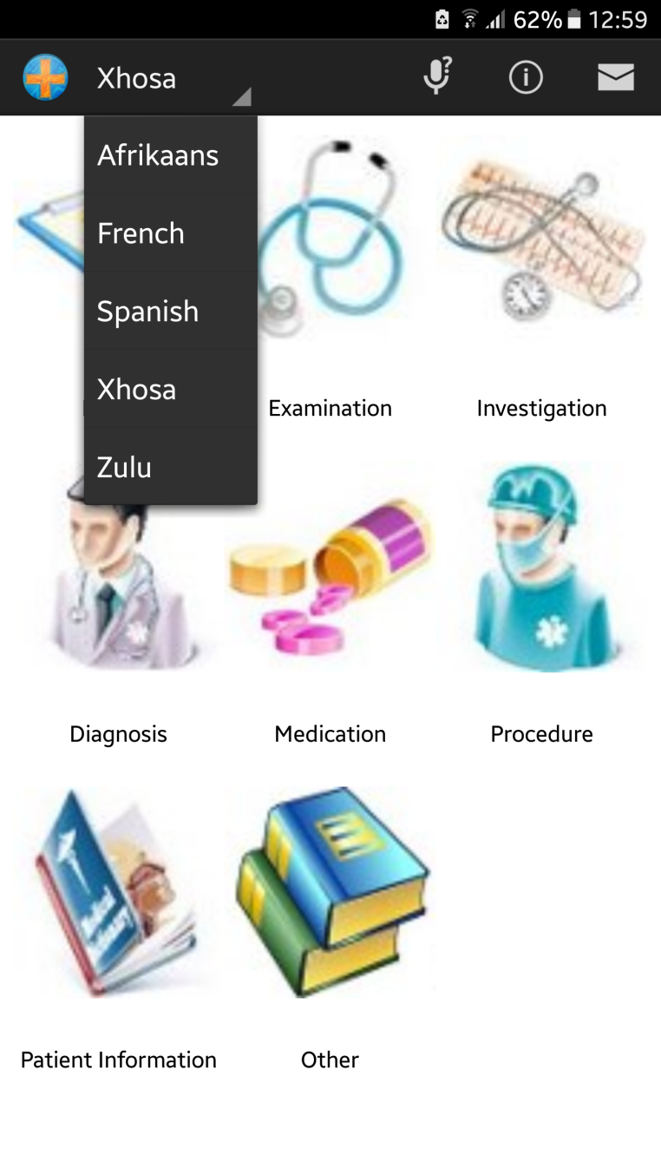
Introduction
Cellphone-based
Direct medical translations
5 Languages
  Afrikaans
  French
  Spanish
  Xhosa
  Zulu

Slide 14
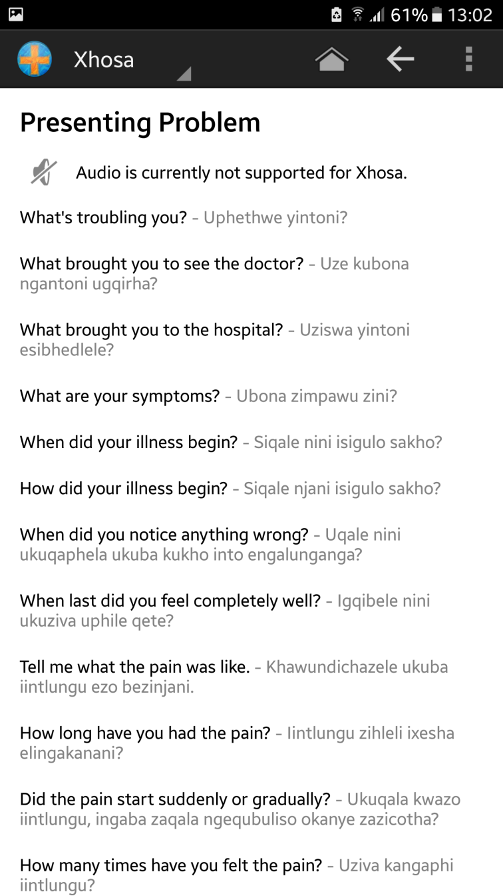
Topics
History
Examination
Investigation
Diagnosis
Medication
Procedure
Patient Information
Other

Slide 15
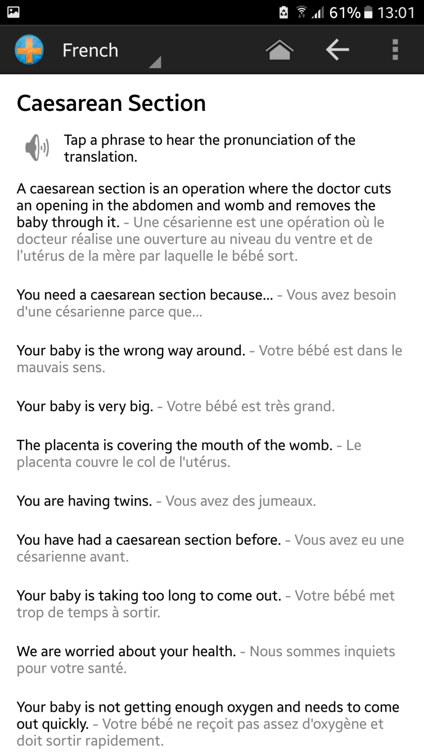
Additional Features
Audio for selected languages
Links to tutorials

Slide 16
Challenges
Pronunciation
Patient responses
Content

Slide 17
Links
Android App
  play.google.com/store/apps/details?id=nfs.mobiletranslatemd
MobileXhosa Website
  mobilexhosa.co.nf
Facebook Page
  facebook.com/mobiletranslate

